Slide 1
B Tree

Slide 2
B Tree Motivation
When data is too large to fit in main memory, we will have to use disk storage, then the number of disk accesses becomes important.
A disk access is unbelievably expensive compared to a typical computer instruction (mechanical limitations).
One disk access is worth about 200,000 instructions.
The number of disk accesses will dominate the running time

Slide 3
Cont.
It is worth executing lots of instructions to avoid a disk access
Secondary memory (disk) is divided into equal-sized blocks (typical sizes are 512, 2048, 4096 or 8192 bytes)
The basic I/O operation transfers the contents of one disk block to/from main memory.
The solution is to use more branches and thus less height!
As branching increases, depth decreases
Our goal is to devise a multiway search tree that will minimize file accesses (by exploiting disk block read).

Slide 4
Multiway Search Trees (of order m)
A generalization of binary search trees.
Each node has at most m children.
If m is the number of children, then the node has exactly k-1 keys.
The tree is ordered

Slide 5
B Tree Definition
A B-Tree of order M is an M-Way tree with the following constraints
  The root is either a leaf or has between 2 and M subtrees
  All interior node (except maybe the root) have between ⎡M / 2⎤ and M subtrees (i.e. each interior node is at least “half full”)
  All leaves are at the same level.

Slide 6
Special B Trees
For order 3, all the internal nodes of a B tree have a degree that is either 2 or 3. This tree is also known as 2-3 trees.
For order 4, all the internal nodes of a B tree have a degree that is either 2 or 3 or 4. This tree is also known as 2-3-4 trees.

Slide 7
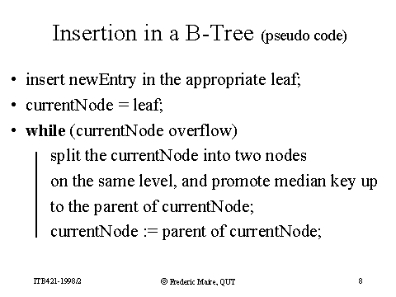

Slide 8
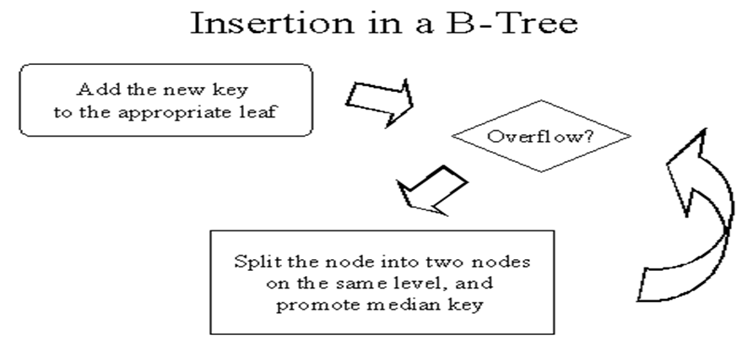

Slide 9
Constructing a B-tree
Suppose we start with an empty B-tree and keys arrive in the following order:1 12 8 2 25 6 14 28 17 7 52 16 48 68 3 26 29 53 55 45
We want to construct a B-tree of order 5
The first four items go into the root:
To put the fifth item in the root would violate condition 5
Therefore, when 25 arrives, pick the middle key to make a new root
1
2
8
12

Slide 10
Constructing a B-tree (contd.)
8
1
2
12
25
6, 14, 28 get added to the leaf nodes:
8
1
2
6
12
14
25
28

Slide 11
Constructing a B-tree (contd.)
Adding 17 to the right leaf node would over-fill it, so we take the middle key, promote it (to the root) and split the leaf
8
17
1
2
6
12
14
25
28
7, 52, 16, 48 get added to the leaf nodes
8
17
1
2
6
7
12
14
16
25
28
48
52

Slide 12
Constructing a B-tree (contd.)
Adding 68 causes us to split the right most leaf, promoting 48 to the root, and adding 3 causes us to split the left most leaf, promoting 3 to the root; 26, 29, 53, 55 then go into the leaves
3
8
17
48
1
2
6
7
12
14
16
25
26
28
29
52
53
55
68
Adding 45 causes a split of
25
26
28
29
and promoting 28 to the root then causes the root to split

Slide 13
Constructing a B-tree (contd.)
17
3
8
28
48
1
2
6
7
12
14
16
25
26
29
45
52
53
55
68

Slide 14
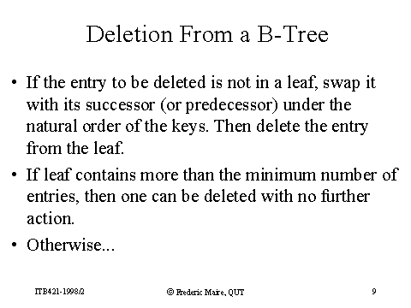

Slide 15
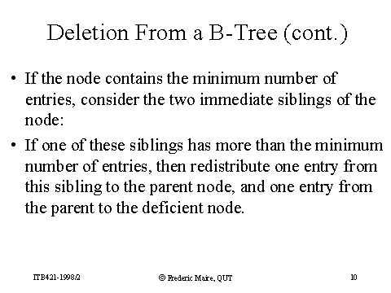

Slide 16
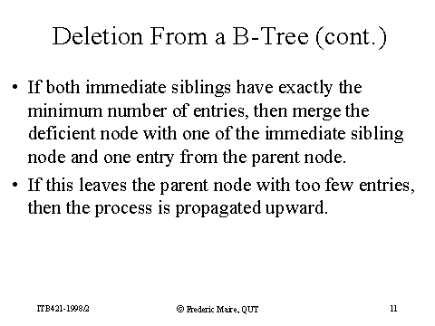

Slide 17
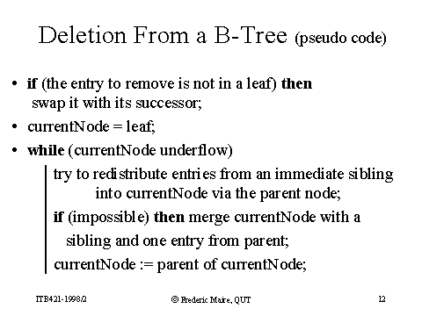

Slide 18
Type #1: Simple leaf deletion
Assuming a 5-way
B-Tree, as before...
12
29
52
2
7
9
15
22
31
43
56
69
72
Delete 2: Since there are enough
keys in the node, just delete it

Slide 19
Type #2: Simple non-leaf deletion
12
29
52
Delete 52
7
9
15
22
31
43
56
56
69
72
Borrow the predecessor
or (in this case) successor

Slide 20
Type #2: Simple non-leaf deletion
12
29
56
Delete 52
7
9
15
22
31
43
69
72
Borrow the predecessor
or (in this case) successor

Slide 21
Type #3: Enough siblings
12
29
Demote root key and
promote leaf key
7
9
15
22
31
43
56
69
Delete 22

Slide 22
Type #3: Enough siblings
12
31
7
9
15
29
43
56
69

Slide 23
Type #4: Too few keys in node and its siblings
12
29
56
Join back together
7
9
15
22
31
43
69
72
Delete 72
Too few keys!

Slide 24
Type #4: Too few keys in node and its siblings
12
29
7
9
15
22
31
43
56
69

Slide 25
Insertion & Deletion Examples

Slide 26
Operations
B-Tree of order 4
  Each node has at most 4 pointers and 3 keys, and at least 2 pointers and 1 key.
Insert: 5, 3, 21, 9, 1, 13, 2, 7, 10, 12, 4, 8
Delete: 2, 21, 10, 3, 4

Slide 27
Insert 5, 3, 21
* 5 *
a
* 3 * 5 *
a
* 3 * 5 * 21 *
a

Slide 28
Insert 9
* 9 *
a
b
c
* 3 * 5 *
* 21 *
Node a splits creating 2 children: b and c

Slide 29
Insert 1, 13
* 9 *
a
b
c
* 1 * 3 * 5 *
* 13 * 21 *
Nodes b and c have room to insert more elements

Slide 30
Insert 2
* 3 * 9 *
a
b
d
c
* 1 * 2 *
* 5 *
* 13 * 21 *
Node b has no more room, so it splits creating node d.

Slide 31
Insert 7, 10
* 3 * 9 *
a
b
d
c
* 1 * 2 *
* 5 * 7 *
* 10 * 13 * 21 *
Nodes d and c have room to add more elements

Slide 32
Insert 12
* 3 * 9 * 13 *
a
b
d
c
e
* 1 * 2 *
* 5 * 7 *
* 10 * 12 *
* 21 *
Nodes c must split into nodes c and e

Slide 33
Insert 4
a
* 3 * 9 * 13 *
b
d
c
e
* 1 * 2 *
* 4 * 5 * 7 *
* 10 * 12 *
* 21 *
Node d has room for another element

Slide 34
Insert 8
a
* 9 *
f
g
* 3 * 7 *
* 13 *
b
d
h
c
e
* 1 * 2 *
* 4 * 5 *
* 8 *
* 10 * 12 *
* 21 *
Node d must split into 2 nodes. This causes node a to split into 2 nodes and the tree grows a level.

Slide 35
Delete 2
* 9 *
a
f
g
* 3 * 7 *
* 13 *
b
d
h
c
e
* 1 *
* 4 * 5 *
* 8 *
* 10 * 12 *
* 21 *
Node b can loose an element without underflow.

Slide 36
Delete 21
* 9 *
a
f
g
* 3 * 7 *
* 12 *
b
d
h
c
e
* 1 *
* 4 * 5 *
* 8 *
* 10 *
* 13 *
Deleting 21 causes node e to underflow, so elements are redistributed between nodes c, g, and e

Slide 37
Delete 10
* 3 * 7 * 9 *
a
b
d
h
e
* 1 *
* 4 * 5 *
* 8 *
* 12 * 13 *
Deleting 10 causes node c to underflow. This causes the parent, node g to recombine with nodes f and a. This causes the tree to shrink one level.

Slide 38
Delete 3
* 4 * 7 * 9 *
a
b
d
h
e
* 1 *
* 5 *
* 8 *
* 12 * 13 *
Because 3 is a pointer to nodes below it, deleting 3 requires keys to be redistributed between nodes a and d.

Slide 39
Delete 4
* 7 * 9 *
a
b
h
e
* 1 * 5 *
* 8 *
* 12 * 13 *
Deleting 4 requires a redistribution of the keys in the subtrees of 4; however, nodes b and d do not have enough keys to redistribute without causing an underflow. Thus, nodes b and d must be combined.

